Slide 1
Python programming
unit 3 – Tuple, list, set, dict

Slide 2
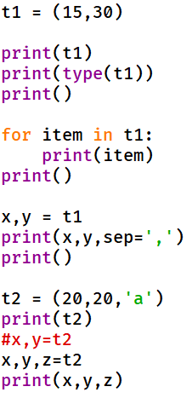
tuple
A collection / combination of many data
Empty tuple, one item tuple
Is immutable
Items are ordered. (switch item order is different tuple)
Iterable: Can be iterated for each item
Can unpack and assign each item to one variable using one single assignment operator
Index, slicing (similar to string data type)
+ operator to merge tuple

Slide 3
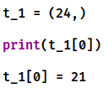
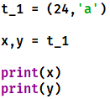


In class practice: what is the result for those code?

Slide 4
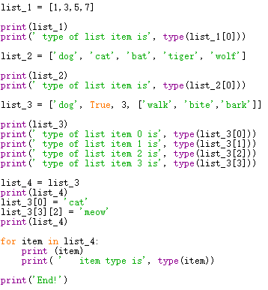
list
List is a collection of many items. Each item can be integer, string, bool, even item can be another list
unpack
List items can be accessed using item index []
Slicing: sub list
Iterable: list items can be iterated with for loop
Mutable, can change item
If 2 variables assigned to same list, change the list will change both variables
+ operator to merge list

Slide 5

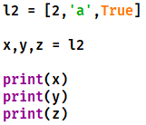


In class practice: what is the result for those code?

Slide 6
List assignment, copy, deepcopy
list_a = list_b
When direct use assignment ‘=‘, the two variables are actually same object. Can use id() to verify
Change the list using one variable, the other variable will also affected.
Use list copy(), two variable will be different. But if the item is a list again, then that item will still be referring to same object, change one list item’s value will affect the other
Use deepcopy: will copy all items even it is a list, and two variable will be completely independent.
list_a
[
]
list data
list_b
list_a = list_b.copy()
[
]
list_a
item1
item2
[
]
item1
…
list_b
[
]
item1
item2
[
]
[
]
list_a = copy.deepcopy(list_b)
list_a
item1
item2
list_b
item1
item2
[
]
[
]
item1
…
item1
…

Slide 7
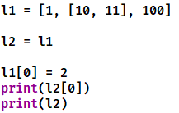
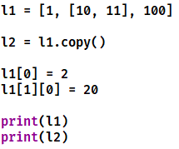
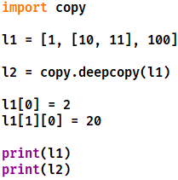
In class practice: what is the result for those code?

Slide 8
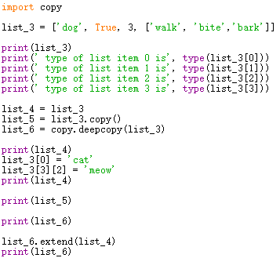
List functions
Method | Description
append() | Adds an element at the end of the list
clear() | Removes all the elements from the list
copy() | Returns a copy of the list (shallow copy)
count() | Returns the number of elements with the specified value
extend() | Add the elements of a list (or any iterable), to the end of the current list
index() | Returns the index of the first element with the specified value
insert() | Adds an element at the specified position
pop() | Removes the element at the specified position, return value
remove() | Removes the item with the specified value
reverse() | Reverses the order of the list
sort() | Sorts the list
✔
✔
✔
✔

Slide 9
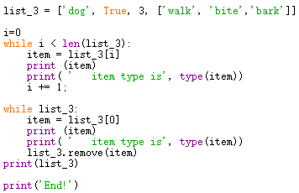
While loop
while (bool test)
[while statement blocks]
while True, is same like forever in Scratch
If change the list during the loop execution, better not use for loop, use while loop instead.
Implicit conversion from list to bool
Same effect as :
list_3 != []

Slide 10
Queue (FIFO)
Data is take out from queue head to be processed
List[0]
Python list is a nature to be used a queue.
New data was added at the end of queue, using append() function
Data to be processed taken from list beginning, using pop(0)
List[1]
List[2]
List[3]
List[4]
New Data is added at the end of queue

Slide 11
Stack (LIFO)
New Data is added nearest end
Data is take out from the nearest end to be processed
Python list also can be easily used as a stack.
New data was added at the end, using append() function
Data to be processed taken from list end, using pop(-1)
List[-1]
List[-2]
List[-3]
List[-4]
List[-5]

Slide 12
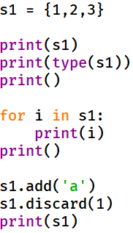
SET
Python set is another data which is a collection of other objects.
Unpack: notice because set is not ordered, so unpack order maybe different as you think.
Set is similar to list, but it’s data is unordered, unindexed.
Iterable
Set do not allow duplicate value. All value must be different with each other.
Can not change item. But can add item, can remove item.
| oerator to merge set (union)

Slide 13




In class practice: what is the result for those code?

Slide 14
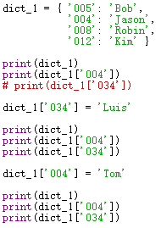
dict
dict is a collection of many items, each item has two part: key and value. Also called key:value pairs
Using keys to subscript get the corresponding value
The assign operator will create one item if key does not exist. If key already exist it will update the value

Slide 15
dict
fromkeys() function, a dictionary function can generate a dict with a list of keys
Zip function: can map two list and then convert it to dict using dict()

Slide 16
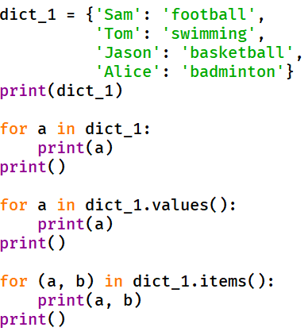
dict
Unpack: direct unpack will get keys.
Unindexed.
Iterabe: Use the for loop. Together with values(), keys() or items() to get what you need.

Slide 17
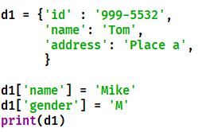
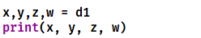





In class practice: what is the result for those code?

Slide 18
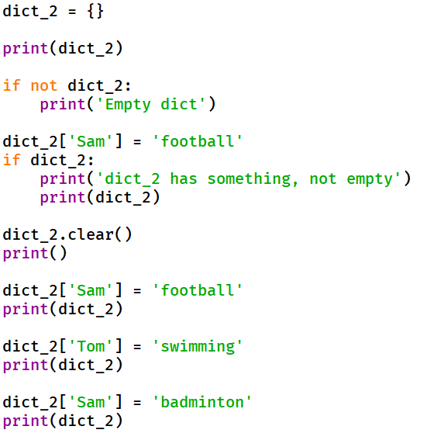
Dictionary methods
Method | Description
clear() | Removes all the elements from the dictionary
copy() | Returns a copy of the dictionary (shallow copy)
fromkeys() | Returns a dictionary with the specified keys and value
get() | Returns the value of the specified key
items() | Returns a list containing a tuple for each key value pair
keys() | Returns a list containing the dictionary's keys
pop() | Removes the element with the specified key, return value
popitem() | Removes the last inserted key-value pair
setdefault() | Returns the value of the specified key. If the key does not exist: insert the key, with the specified value
update() | Updates the dictionary with the specified key-value pairs
values() | Returns a list of all the values in the dictionary
✔
✔
✔

Slide 19
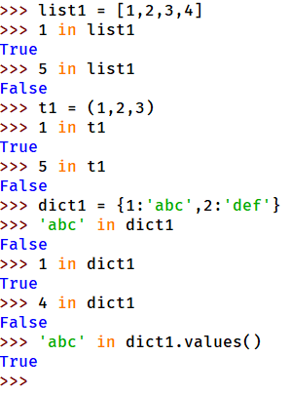
In operator
Beside used with for to iterate a collection, it can be used to : Check for membership.

